Slide 1
EPD simulation status
Roland Pintér, Máté Csanád Eötvös University

Slide 2
S&C meeting
No meeting this Wednesday
Jason replied that there will be no general S&C meeting in the near future
However, “Embedding and Simulation” meetings will be held, but no date yet
Could be useful for our upcoming questions!
One issue: pt = -999 for secondary MuMcTracks
Jason said this default value (-999) would mark secondary tracks indeed
But instead of pt, eta should be -999 (which is -999 as well, will show later on)
Open question: why is pt = -999 for secondary MuMcTracks? ← Jason will look into this
Daniel Brandenburg wrote to us from S&C and offered help
6 questions asked from him, waiting for reply (details on last slide)

Slide 3
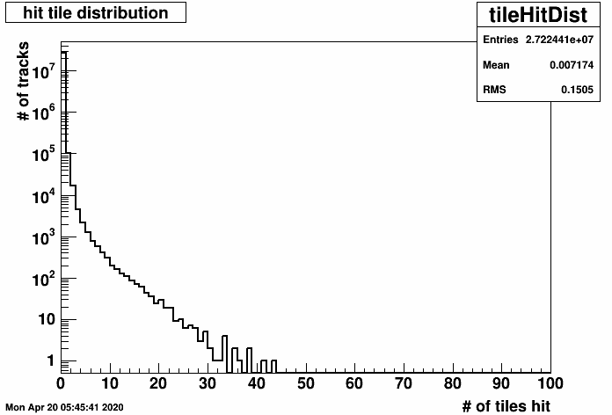
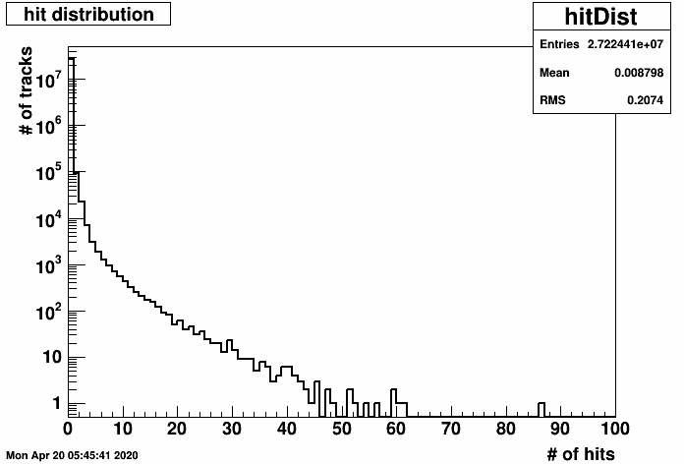
Some numbers (AuAu 200 GeV b=[0,15] 180 events)
27.2M tracks in total, 574k primary, rest secondary
240k EPD hits (5k hits caused by zero-charge secondaries – minor glitch?)
88k hits are given by primaries
152k hits are given by secondaries
132k primary tracks (out of 574k, ~22%) cause 240k EPD hits (directly+indirectly through secondaries)
Number of tiles hit by a primary track (or its shower):
105k (79.2%) hit 1 tile
15k (12.4%) hit 2 tile
4k (3.4%) hit 3 tile
2k (1.6%) hit 4 tile
and so on, sum of the above is 132k
Number of hits created by a primary track (or its shower)
92k create 1 hit (directly or through a secondary)
23k create 2 hits (directly or through secondaries)
7k create 3 hits (directly or through secondaries)
and so on, and 92k+2∙23k+3∙7k+… adds up to 240k

Slide 4
Open issue: secondaries from EPD material
What about the 37k hits from secondaries created inside the EPD?
These represent a ~15% fraction of the 240k hits
Are these gammas (e.g. from pi0) creating pairs inside EPD?
Quick investigation: these secondaries from inside the EPD are many kinds:
e⁻ from π± (23% = 8.6k)
e⁻ from e⁻ (10% = 3.7k)
e⁻ from γ (10% = 3.7k)
e⁻ from e⁺ (8% = 2.9k)
P from π⁻ (5% =1.8k)
e⁺ from γ (5% = 1.7k)
and many other processes, even 2.2% ²H from π± and 1% ³H from π±
Still not clear how to handle these: primary or secondary? Why do they exist in the simulation?

Slide 5
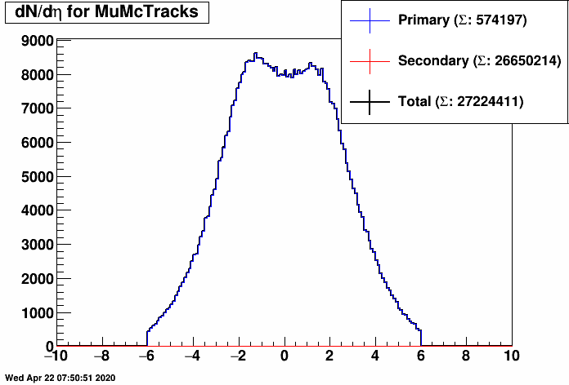
dN/dEta for MuMctracks
Eta for secondary MuMcTracks = -999
(Recap: -999 marks secondaries indeed)
(But pt should not be -999 for them!)
27.2M Tracks
574k primary (~2.3% of total tracks)
26.6M secondary (~97.7% of total tracks)

Slide 6
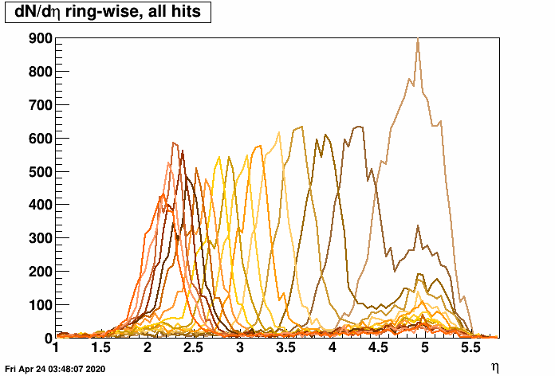
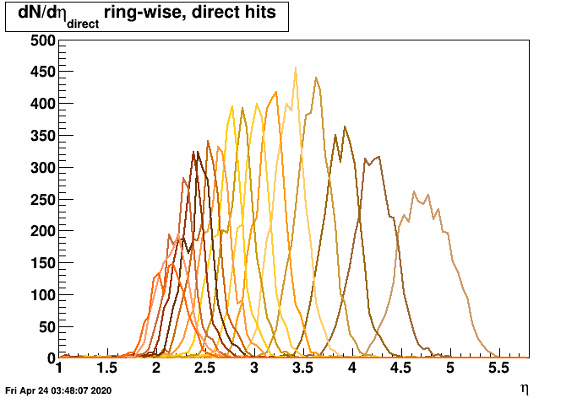
dN/dEta of EPD hits, ring-wise
Eta on the plots: pseudorapidity of primary track (132k) creating given hit
Direct hits: created by primaries (all: also hits from secondaries)
Lesson: broader distribution from secondaries, very broad ”plateau”

Slide 7
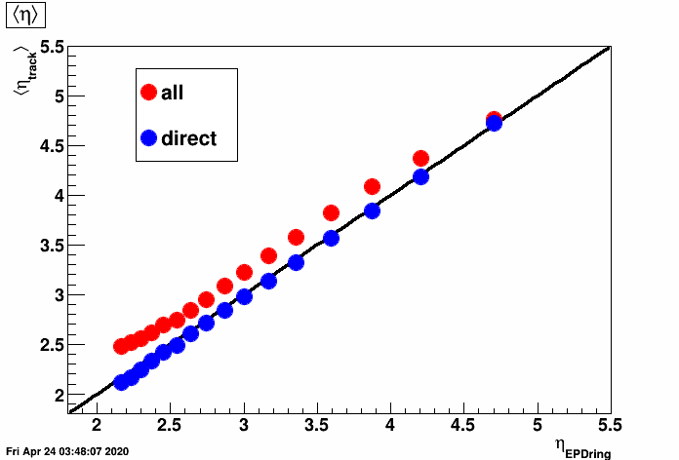
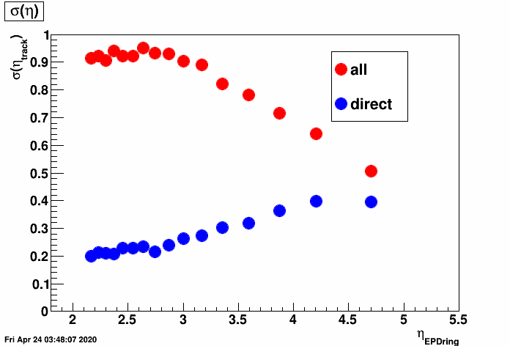
Average & deviaton of eta, ring-wise
Here η_{track}: of primary track creating hit; η_{EPDRing}: of tile center of EPD rings
Direct hits: created by a primary directly (i.e. not through secondaries)
Average: somewhat shifted; Std.dev.: much larger, esp. for central tiles

Slide 8
Open issues
5k hits (out of 240k) in EPD caused by zero-charge secondaries – minor glitch?
Primary particles are those with vertex id = 1 (belonging to main vertex)?
What does shower and notshower mean?
McTrack::IdVx() and McVertex::IdParTrk(): correct way to trace parent tracks?
Secondaries originating from EPD: are those primaries really?
Why is eta and pt=-999 for many secondary tracks, how to treat this?
How to create a "particle gun" type of simulation?
Asked these from Daniel Brandenburg who offered help (after S&C list email)

